Slide 1
BedfordBID virtual AGM February 2025
2023/24 Annual Review
2024/25 Interim Review

Slide 2


BedfordBID virtual AGM February 2025
2023/24 Annual Review
Transparency and Accountability
Each year, in accordance with Business Improvement Regulations, an annual review report is prepared and made available for all levy payers and new business openings in the BID zone.
The review provides an overview of the programme of full activities, measurement, evaluation and expenditure of the respective financial year.
This document also outlines and recaps on the agreed aims and key themes agreed for the BID term in the five-year business plan.
In the spirit of full transparency, the document is also loaded online for full access.

Slide 3
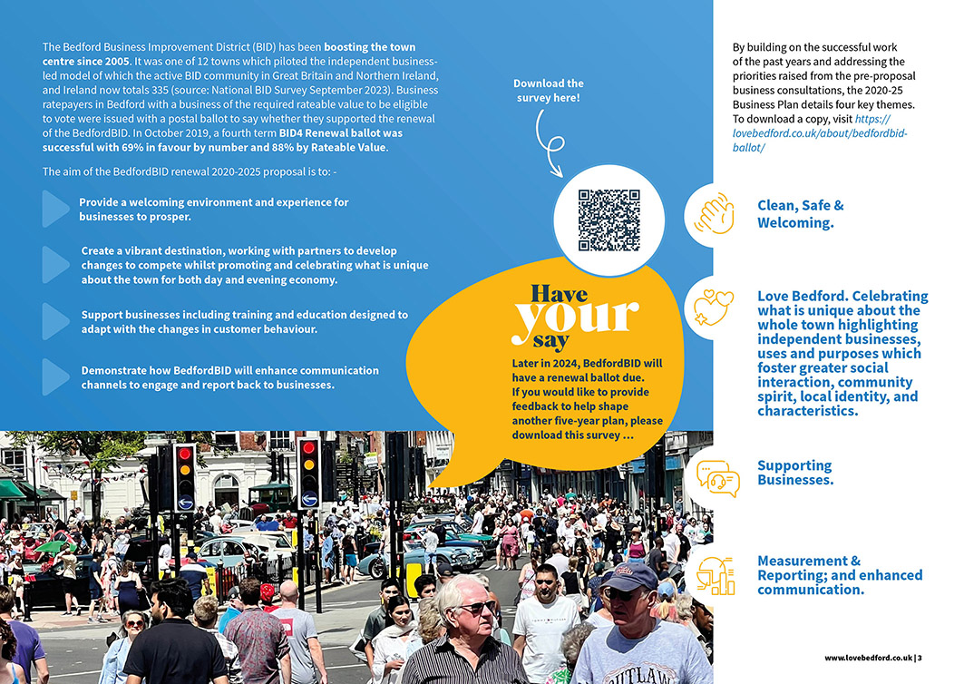
BedfordBID virtual AGM February 2025
2023/24 Annual Review document recap
BedfordBID agreed aims and themes.

Slide 4
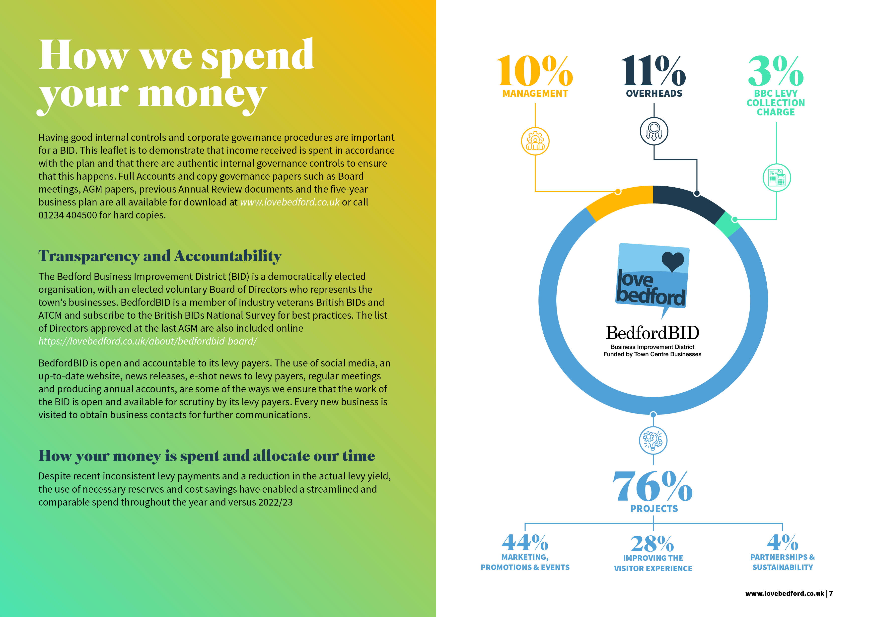
BedfordBID virtual AGM February 2025
2023/24 Annual Review document recap
BedfordBID levy money is from businesses within a defined area and those with a business rateable value higher than £12,000.
Money can only be spent when funds are received. It is ring-fenced for use only on BID projects and initiatives.
BIDs cannot subsidise local authority statutory obligations, however, BIDs can enhance services.

Slide 5
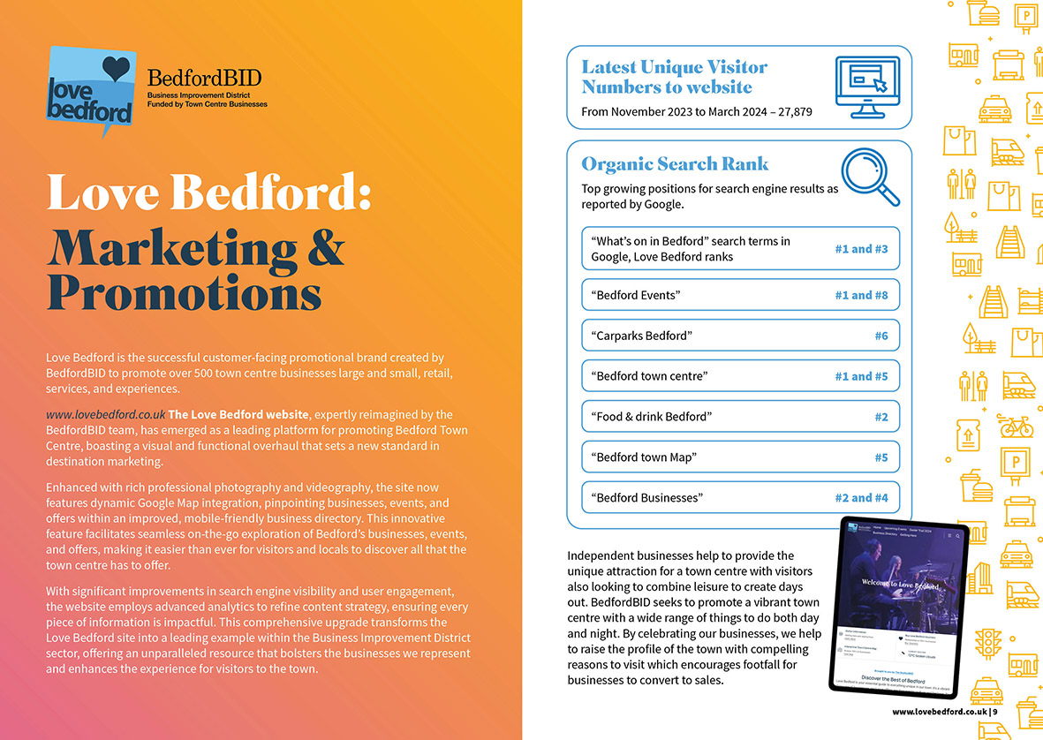
BedfordBID virtual AGM February 2025
2023/24 Annual Review document recap
Love Bedford website promotes all about Bedford, it’s businesses and events.
And over the past 9 months: ...
Active users: 239,989
Event count: 625,084

Slide 6
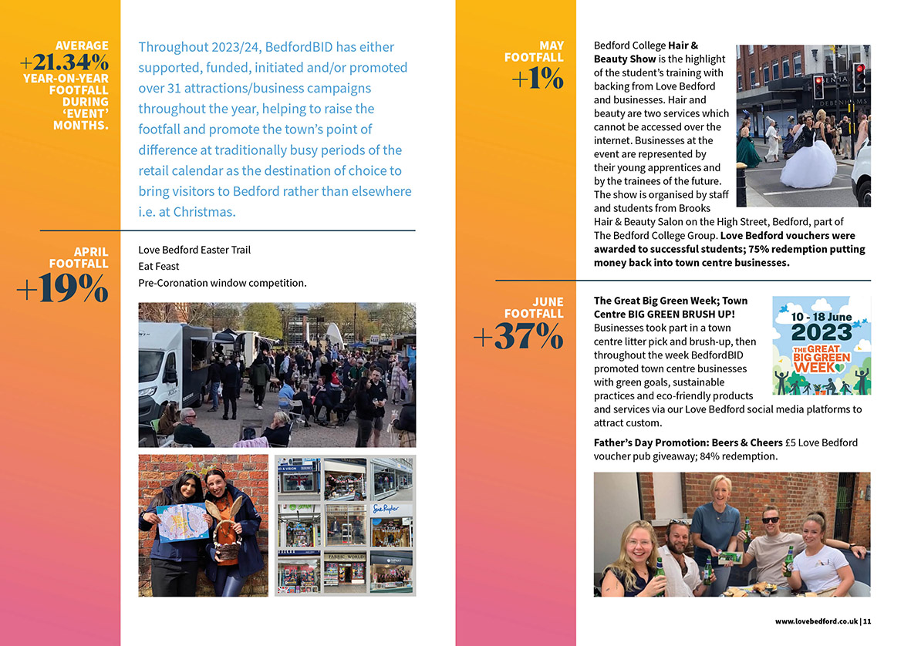

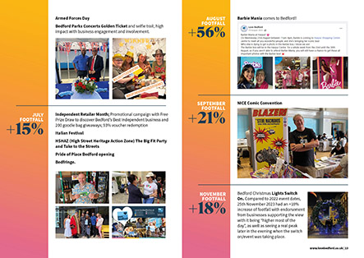
BedfordBID virtual AGM February 2025
2023/24 Annual Review document recap
PROJECTS …
Love Bedford Marketing & Promotions

Slide 7
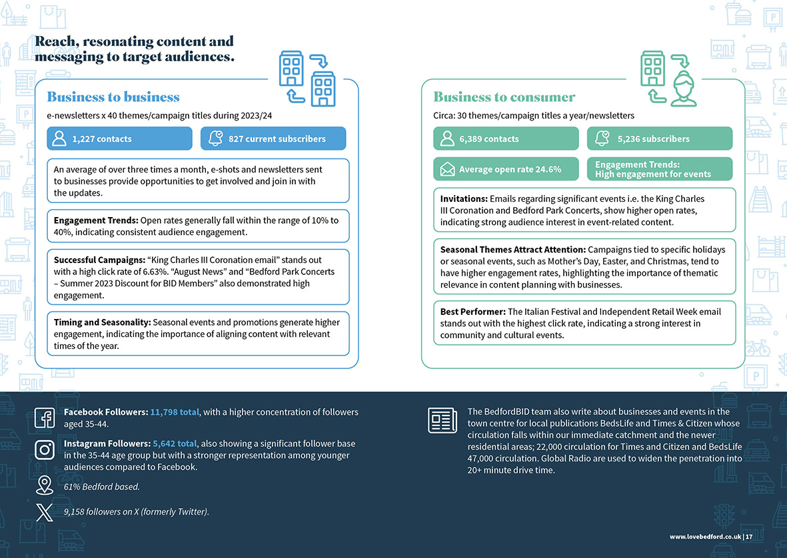
BedfordBID virtual AGM February 2025
2023/24 Annual Review document recap
B2B and B2C analysis

Slide 8
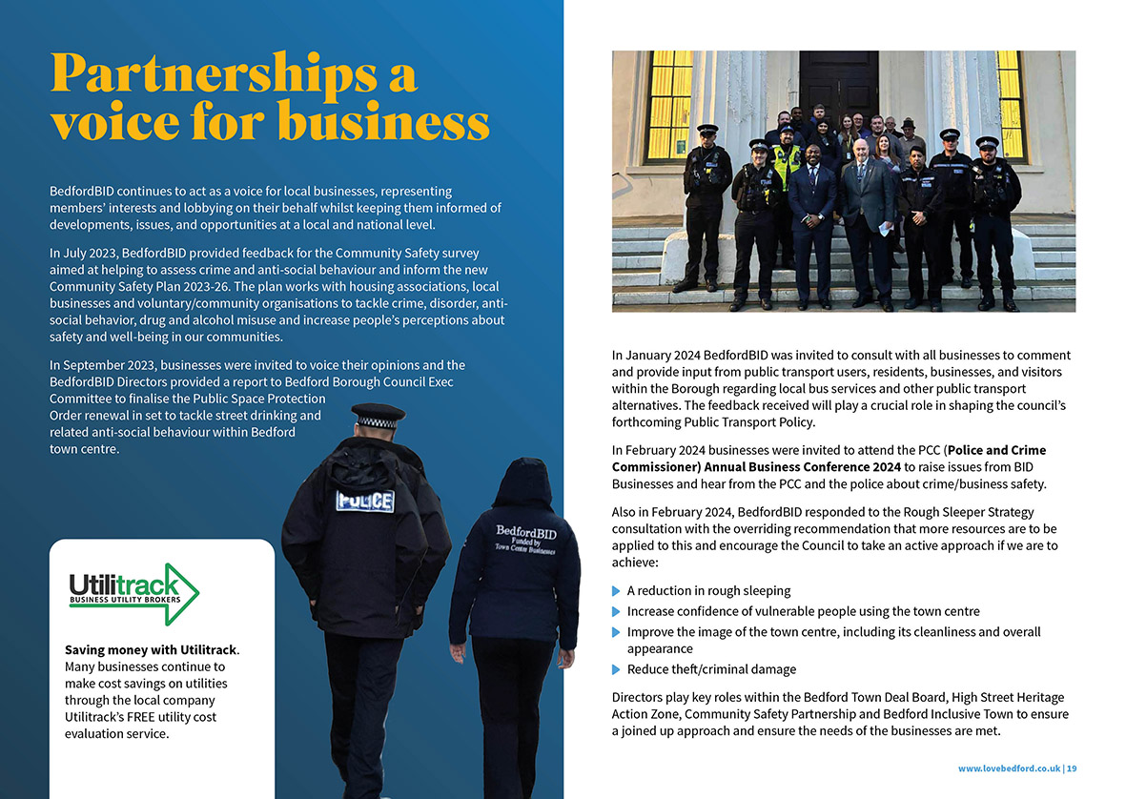
BedfordBID virtual AGM February 2025
2023/24 Annual Review document recap
BedfordBID provides a voice for businesses and support with crime reduction and safety initiatives.
The team also communicate, and signpost matters of importance and interest to the business community including the community safety survey, consultations, Public Space Protection Order renewal and help shape the Council’s Public Transport Policy.

Slide 9
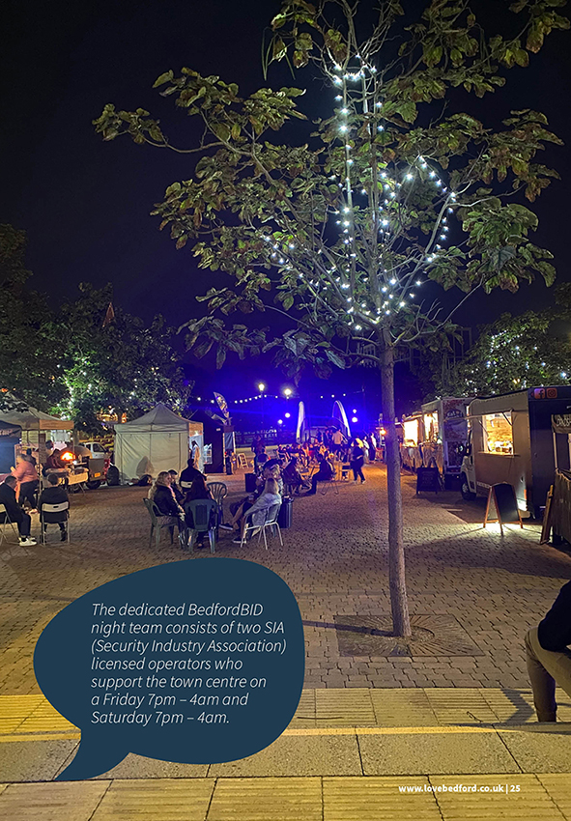
BedfordBID virtual AGM February 2025
2023/24 Annual Review document recap
Improving the Visitor Experience; partnerships
The BedfordBID Champions have been an integral part of the town centre landscape and Bedford’s business community for many years. They act as the ‘eyes and ears’ of the town and also link between businesses, emergency services and relevant council services.
All staff are first aid trained and carry out regular weekly checks, updates and reprovisioning of town centre defibrillators. During 2023/24, 376 separate graffiti, StreetLink street cleansing and highway engineers’ reports were reported by the frontline team.
The dedicated BedfordBID night team support the town at weekends as well as provide taxi marshalling services at the end of the night.
BedfordBID also acts as secretary for the BedSafe group (town centre licensees) organising membership, meeting invites, minutes and communications. BedfordBID arranges and
covers the insurance costs for the banned scheme and in the past have provided
accredited training courses for venue staff to attend.

Slide 10
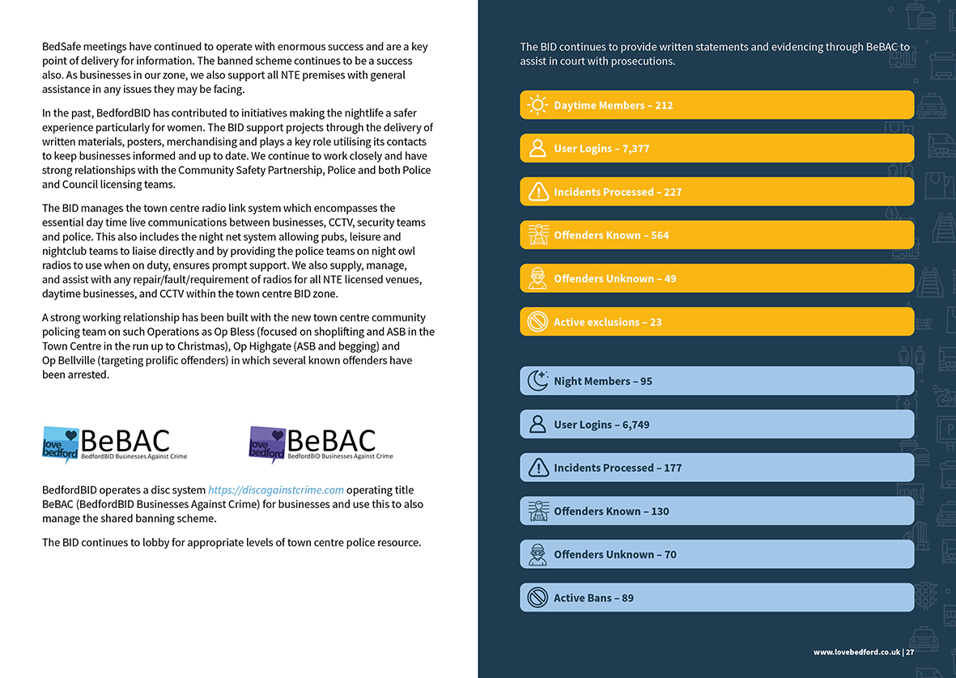
BedfordBID virtual AGM February 2025
2023/24 Annual Review document recap
Improving the Visitor Experience; partnerships
BedfordBID introduced and developed the BedfordBID Businesses Against Crime (BeBAC) initiative for the town’s day and nighttime economy sector.
This is a business crime partnership to help tackle anti-sociable behaviour and other town-based crime.
BedfordBID helped to launch the Tap and Donate contactless donation
pointed located at IMPAKT in The
Arcade in association with Bedford
Homeless Partnership.

Slide 11
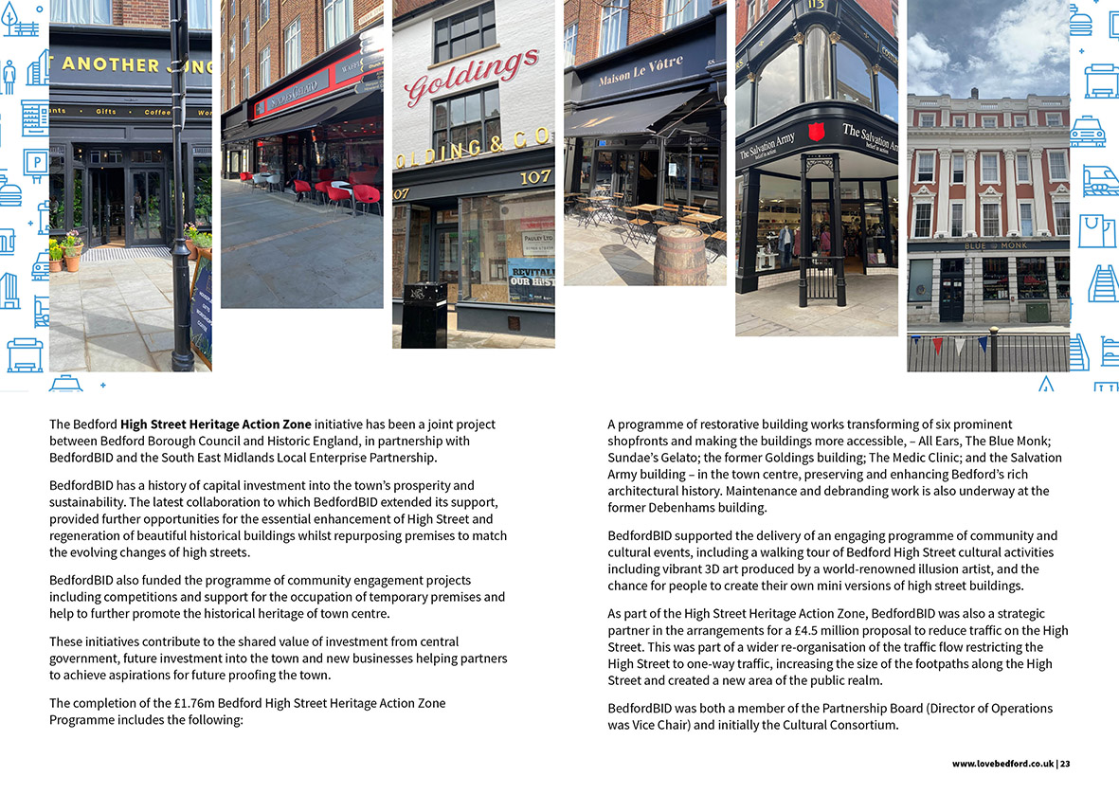
BedfordBID virtual AGM February 2025
2023/24 Annual Review document recap
Improving the Visitor Experience; partnerships
BedfordBID was invited to join the Partnership Board whose purpose was to oversee the development and delivery of the High Street Heritage Action Zone programme in Bedford town centre.
Directors also play roles within the Bedford Town Deal Board, High Street Heritage Action Zone Community Grants applications, Community Safety Partnership, Bedford Inclusive Town and Enhance Partnership for the Bus
Service Improvement Plan to create
a joined-up approach in meeting the
needs of the business community.

Slide 12
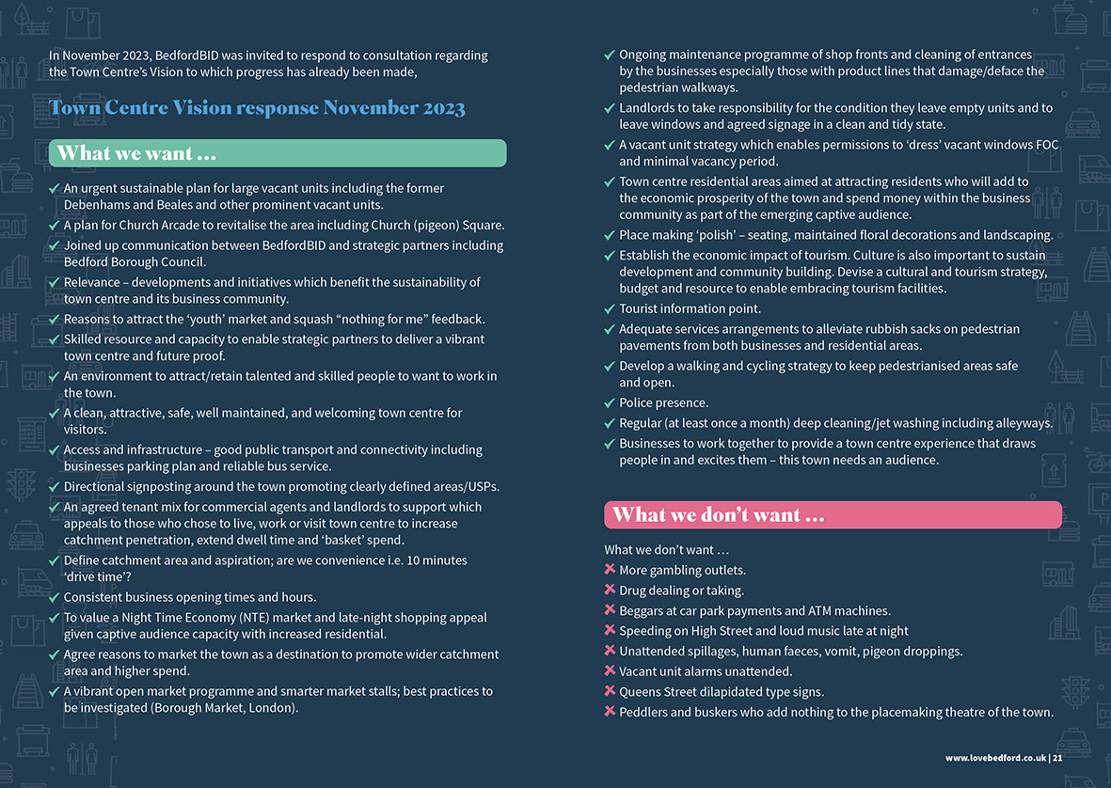
BedfordBID virtual AGM February 2025
2023/24 Annual Review document recap
Partnerships …
BedfordBID welcomed the opportunity to contribute to the Town Centre Visioning consultation and express matters of priority to be addressed.
Significant progress has since been made.

Slide 13
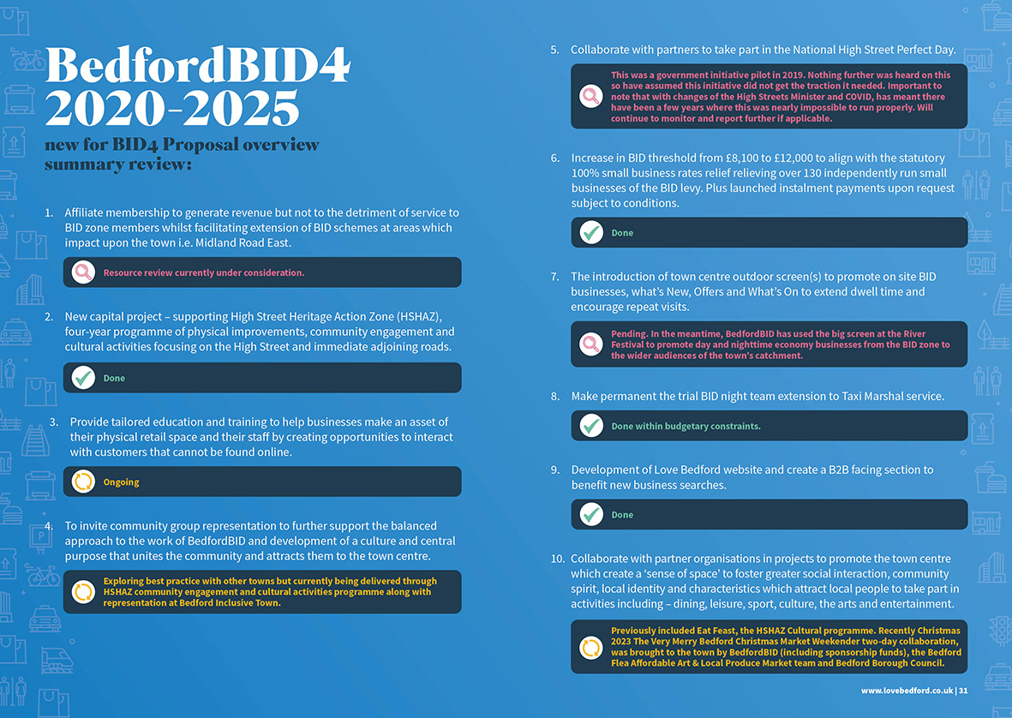
BedfordBID virtual AGM February 2025
2023/24 Annual Review document recap
BID4 overview; Scrutiny
Each BID term, an overview of the five-year business plan proposals are highlighted and reported against.
Progress is shared with businesses each year.

Slide 14
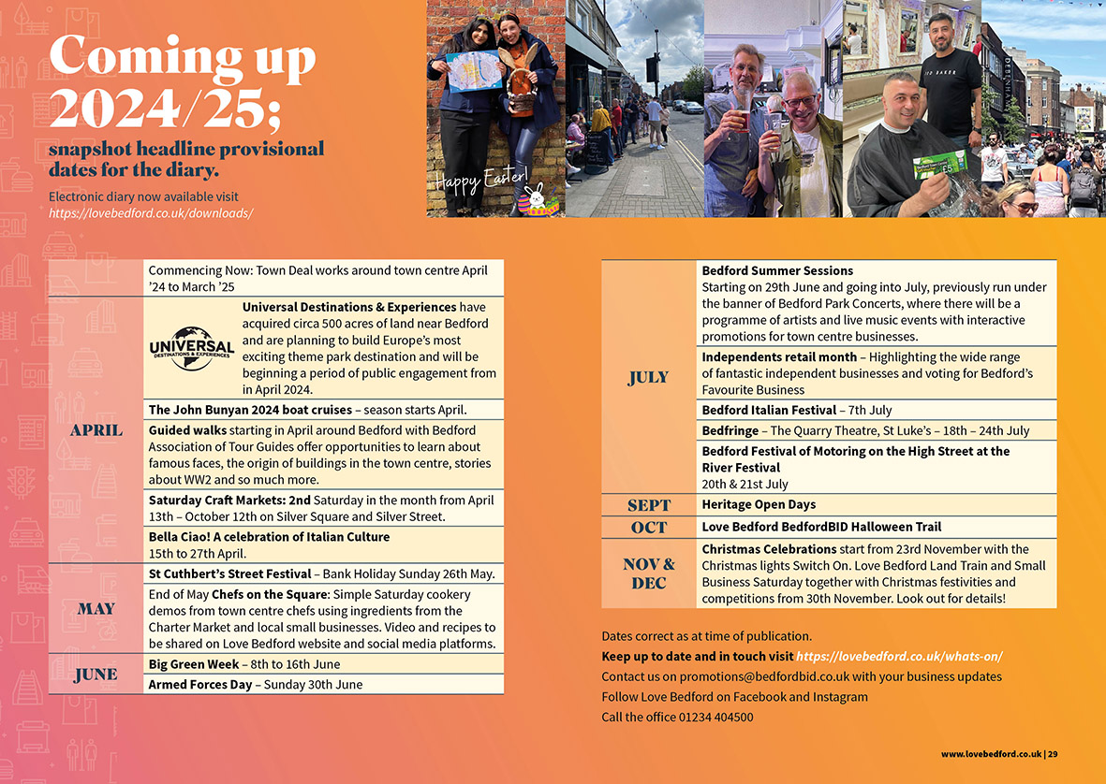
BedfordBID virtual AGM February 2025
2023/24 Annual Review document recap
Scrutiny …
At the beginning of each financial year, headlines are also published in the annual review.
This is designed to introduce plans for the year ahead and provide further scrutiny opportunities.

Slide 15


BedfordBID virtual AGM February 2025
2024/5 interim review
Update 29/01/2025
Chancellor of the exchequer gives unequivocal backing to East West Rail –
Universal Studios proposed theme park – supported by BedfordBID
In the much-anticipated speech around
plans for the UK’s economic growth, the
chancellor of the exchequer gave her
unequivocal support for the East West
Rail infrastructure project which will run
from Oxford to Cambridge through Bedford Borough.
In a recent parliamentary tourism
debate, it was noted that: "Universal
could be the key to unlock the
Government's growth mission in
Bedfordshire." Negotiations for a Universal Studios theme park remain ongoing, despite speculation that the proposed 700-acre development in Kempston Hardwick, Bedfordshire, would be mentioned in Chancellor Rachel Reeves' speech about growth on 29/01/2025.
Further updates are expected shortly when, if plans moved forward, it would "help facilitate" a number of upgrades to the area, such as the construction of new railway stations, new slip roads from the A421 and upgrades to Manor Road.
Universal claims about 8,000 jobs would be created in the area once the resort became operational and after two decades, that number would rise to 10,000.

Slide 16
BedfordBID virtual AGM February 2025
2024/5 interim review
The BID Company can only spend monies received. During 2024/25 the Company has been using existing reserves to fulfil its mandated legal obligations and honour voucher redemptions etc. The Council retains levies collected and held in their separate BID Revenue Account until passed to the BedfordBID Company to spend.
Since the results of the unsuccessful ballot were declared in October 2024, the BID team have been dealing with the Company closure as well as continue its obligation to operate a normal year of activity and process costs for 2024/25. A WIP cash flow forecast for the wind-up is also being attended to with draft accounts to be published in due course.

Slide 17

BedfordBID virtual AGM February 2025
2024/25 Annual Review activity interim snapshot

Slide 18
BedfordBID virtual AGM February 2025
2024/25 Annual Review activity interim snapshot
Improving the Visitor Experience -
BeBAC Daytime Members – 210
BeBAC Nighttime Members – 119
Between April and early December ‘24 (final count to be completed), 197 graffiti, StreetLink, Street cleansing and highway engineers’ reports were processed by the frontline team.
The BID team continued to carry out regular weekly checks, updates, and reprovisioning of the town centre defibrillators at High Street, Star and Bedford Rowing Clubs and bus station.
Stats for the BeBAC initiative continue to be recorded with interim results as shown.
User Logins – 4781
User Logins – 5603
Incidents Processed – 123
Incidents Processed – 102
Offenders Known – 531
Offenders Known- 139
Offenders Unknown – 29
Offenders Unknown – 82
Active exclusions – 20
Active exclusions – 73

Slide 19

BedfordBID virtual AGM February 2025
2024/25 Annual Review activity interim snapshot
Marketing & Promotions; Love Bedford gift vouchers
Overall average of sold voucher redemption rate to date
40.5%
Headline FOC promotional redemption rates to date:-
Brooks Hair & Beauty Show
69%
Easter Trail Winner
100%
Summer Safari Trail
100%
IMPAKT Halloween Trail
100%

Slide 20
BedfordBID virtual AGM February 2025
2024/25 Annual Review activity interim snapshot
Love Bedford: Marketing & Promotions
5409 mailing list subscribers
Love Bedford website views
239,989
Total Emails Sent: 93,151
Top Performing Emails
Amenities at the Town Centre
(River Festival weekend) Send Date: 2024-07-18
Open Rate
16.39%
2024 Golden Ticket Weekend
Craft Market and First Flea of the Year Send Date: 2024-05-10
Open Rate
34.79%
Universal Destinations and Experiences
Send Date: 2024-04-12
Open Rate
36.68%
Love Bedford event count 625,084
Facebook Active Followers over 12,000; 296.000 posts

Slide 21
BedfordBID virtual AGM February 2025
2024/25 Annual Review activity interim snapshot
Social Media Performance Overview
Approximate Total Impressions/Reach (Annual):
Key Demographics:
1.0–1.2 million
New followers:
+841
12,676 followers
74% female
26% male
57.7% in Bedford
6,225 followers
68% female
32% male
58.7% in Bedford
+883
The largest views over Christmas were on Love Bedford Have Fun Days. Video clip on the night of the set up garnered over 133,000 views and reached over 128,000 accounts.

Slide 22
BedfordBID virtual AGM February 2025
2024/25 Annual Review activity interim snapshot
Engagement B2B
24
new businesses welcomed and engagement with BID schemes
Top Performing Emails Open Rates
11
businesses
closed
Christmas 2024 - Last Christmas
Independent Retailer Month, River Festival offers and more (copy 02)
Great Big Green Week Brush Up reminder
849
subscribers
Average Open Rate:
37.5%
41.6%
37.3%
44.9%

Slide 23

BedfordBID virtual AGM February 2025
2024/25 Annual Review activity interim snapshot
BedfordBID promotions, interventions and activities 2024
Based on six main priorities, BedfordBID announced its four-point five-year business plan proposal including:-
Marketing and Promotions – Love Bedford,
Improving the Visitor Experience – Creating Clean, Safe & Welcoming environment,
3. Partnership & Sustainability – Business Support and Collaborations
4. Governance & Transparency.
Armed Forces Day entertainment sponsorship.
Great Big Green Week promotion.
Fathers Day hub.
Brooks Hair and Beauty Awards sponsorship May 2024. Love Bedford voucher promotion for students; 69% redemption rate.
HMO planning application objection intervention at bus station Thurlow Street.
Organised BID5 consultations to establish Bedford’s business community current priorities using business surveys and consultation e-shots, printed material and focus groups.
Produced BID5 five-year business plan proposal based on consultations with stakeholders.
Independent Retailer month promotional activity.
Heritage Bedford booklet sponsorship.
River Festival 2024 High Street promotion and competitions; town centre footflow +7% year on year.
St Cuthberts/town centre SM campaign and Street Festival road closure plus financial support.
Bought in Bedford advertising October 2024.
Easter Trail ; 100% Love Bedford voucher prize winner redemption rate.
Enjoy East Anglia advertorial feature 35,000 circulation.
Installation of new defibrillator at St Peters Street in partnership with ward council funding.

Slide 24


BedfordBID virtual AGM February 2025
2024/25 Annual Review activity interim snapshot BedfordBID promotions, interventions and activities 2024
Festival Of Motoring - 3500 BedfordBID goodie bag giveaways with Love Bedford Vouchers and promotional material from from BID businesses . Free prize draw to win £500 Love Bedford Vouchers for one lucky winner to have a dream weekend eating, drinking and enjoying Bedford’s shops and businesses bolstered consumer
mailing list with over 500 email
address entries. Plus a further 15
runner up prizes donated by town
centre businesses. Essential town
centre information was
handed out along with
online version.
Golden Tickets promo for Bedford Summer Sessions weekend.
Stagecoach and QR code bus travel launch promo and advertising in BedsLife.
Bedfringe 2024 support advert.
Cycle to Work Day promotional activity.
Love Bedford summer holiday Safari Trail; 100% voucher prize winner redemption rate.
Lego Day LEGO® Discover Day funded by BedfordBID designed to introduce children to the fascinating world of Science, Technology, Engineering, Arts, and Mathematics (STEAM) through the power of LEGO® bricks.
To Be Continued – comic event at Corn Exchange sponsorship.
Beer & Cider Festival sponsorship.
Halloween Trail and Mr Pumpkin Head stilt walker.

Slide 25
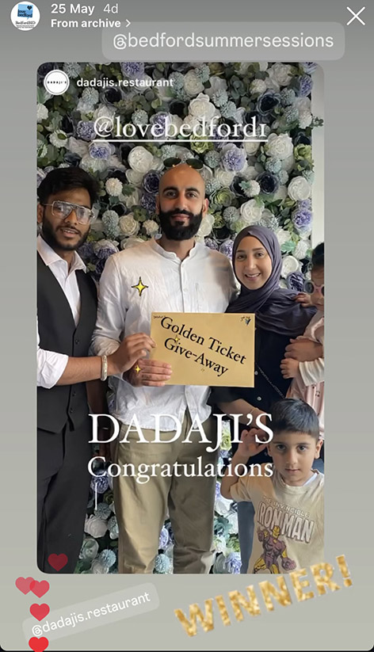
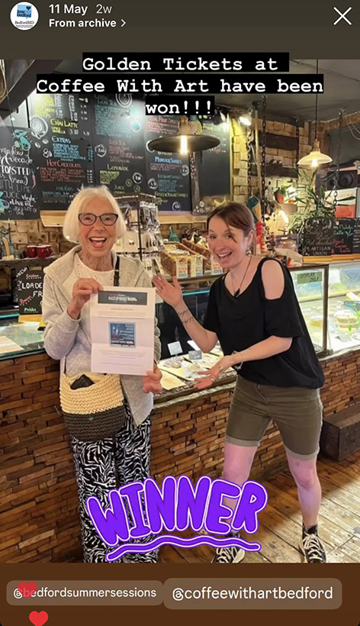
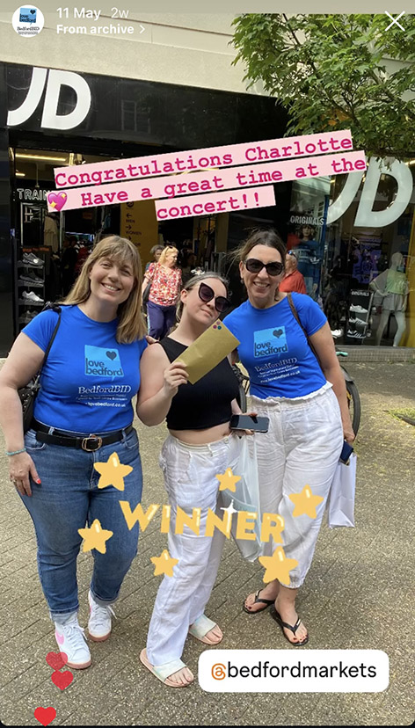
BedfordBID virtual AGM February 2025
2024/25 Annual Review activity interim snapshot BedfordBID promotions, interventions and activities 2024
Bought in Bedford publication support advert.
Christmas lights enhancements at The Broadway, St Peters Street, St Peters Gardens, St Cuthberts Street, Howard Street, Mill Street, Harpur Square, and Harpur Street.
Free standing Christmas Wreath at Silver Square and selfie promo opportunity.
BedfordBID Love Bedford Land Train weekend and free rides.
Christmas lights switch on event with Bedford Music Service Love Bedford sponsored stage live performances and DJ arranged by BedfordBID.
Special offers from businesses for the afternoon and early evening pick me up .
BedfordBID Love Bedford Have Fun! weekend - Golden Angel stilt walker and Cheeky Elf juggler.
Glitter Arty Face Painting and Epic Xtras balloon art.
Golden Tickets weekend: 25 businesses were given a pair of golden tickets to give away at random to one lucky customer. The customer had their photo taken and the business shared it on the business’s social media and tagged Love Bedford. Team shared posts to our stories
BedsLife monthly copy and generic adverts 37,000 copies per month x 12 months plus extra Christmas edition distribution enhancement.
Bands and choirs throughout December.

Slide 26
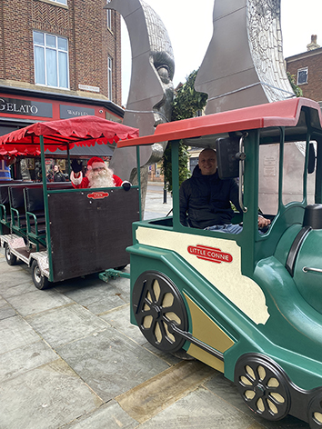
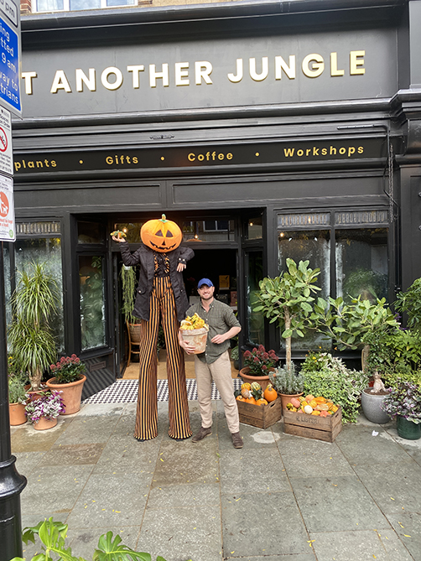
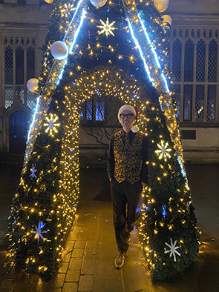
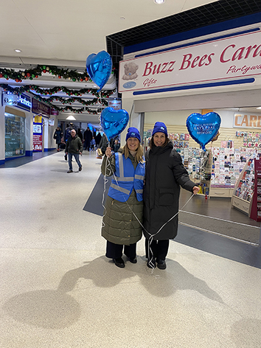

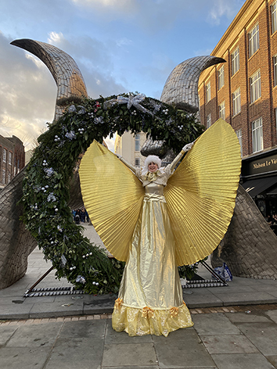
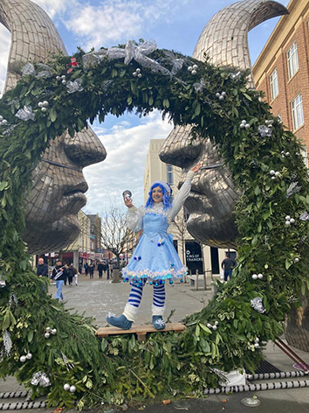
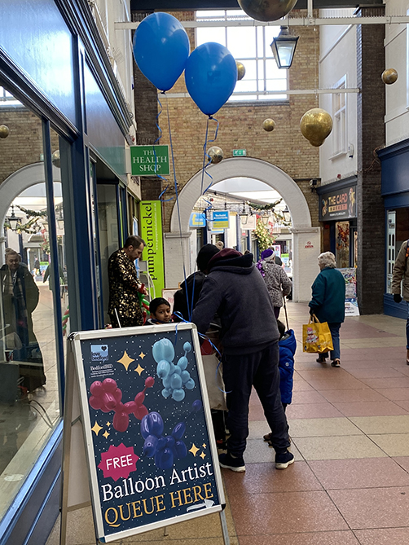
BedfordBID virtual AGM February 2025
2024/25 Annual Review activity interim snapshot BedfordBID promotions, interventions and activities 2024
Halloween Trail: Increase in email addresses captured for the mailing list. Halloween sweetie bags and stickers giveaways with 20% discount vouchers to everyone who went on the trail.
BedfordBID Christmas Window Dressing competition.
Small Business Saturday goodie bag giveaways and SM digital campaign.
BedsLife special 8 pager Christmas edition insert.
“+1% footfall even with the storms. Light switch on Saturday 30th busiest day at Harpur Centre with just under 30k visitors. BedfordBID Love Bedford Have Fun! weekend exceed the same Saturday YOY with 29,268 and even the grotto broke an all time record”
Safari Trail: This included 20 town centre businesses to explore and winner receiving a £20 Love Bedford Voucher.

Slide 27
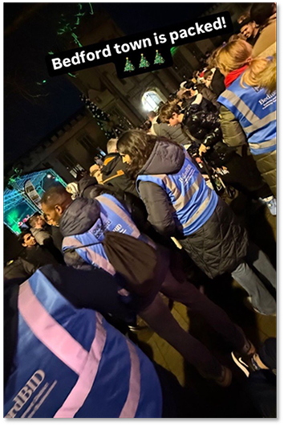
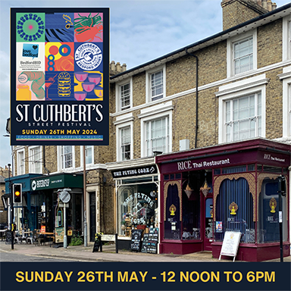
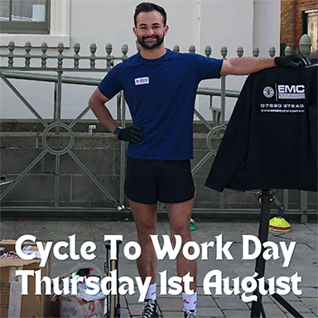



BedfordBID virtual AGM February 2025
2024/25 Annual Review activity interim snapshot
BedfordBID Love Bedford promotions, interventions and activities 2024 social media:
The team shared businesses posts to our stories as we were tagged in by them, and shared posts day and night when spotted things of interest. Business had a 24hr service to be fair.
The largest views over Christmas were on Love Bedford Have Fun Days. Video clips on the night of the set up garnered over 133,000 views and reached over 128,000 accounts.

Slide 28
BedfordBID virtual AGM February 2025
BedfordBID closure 31st March 2025
Following the results of the unsuccessful BID5 ballot, in the absence of a sustainable alternative plan, BedfordBID began immediate negotiations with partners to facilitate the smooth transition and continuation of BID key services as required:-
The responsibility for BID owned Christmas lights (Howard Street and Harpur Square trees) maintenance and insurance transferred to Bedford Borough Council.
Contacts provided to help agree a substitute resource to continue the ongoing monitoring of town centre life saving defibrillators and reporting of faults.
The BedfordBID Businesses Against Crime (BeBAC) day and night systems contract will be terminated as of 31/03/2025 owing to GDPR and data breach probabilities. Video cam evidence will be also destroyed. Therefore, the system’s contractor’s details have been passed on to the Licensing Officer for possible renegotiation if required.
N.B. Should businesses continue to use/share information/images without the proper protocols this is not just illegal but compromises their businesses.
Transference of the Retail Radio Link (day and evening economy) business community network to an external contractor Servicom. This will enable the continuation of the network Ofcom licence whilst working with CCTV and the Community Safety team at the Council who will also provide building access to the radio repeater / antenna system.
Details for the BedSafe and banned scheme have been passed on whilst secretariate services for meetings, protocols and insurance contact details have yet to be confirmed.

Slide 29
BedfordBID virtual AGM February 2025
BedfordBID closure 31st March 2025
BID key services as required continued …
The BedfordBID night team and taxi marshals contract will terminate as of 31/03/2025. This was contracted-out to a local company.
Love Bedford website and social media platforms - Dream Digital (DD) will retain the intellectual property rights for the CRM, codebase and REST API and reserve the right to develop the platform further.
This will enable DD to maintain the integrity & security of the platform going forward. All content and images were owned by or licensed to The BedfordBID Company Ltd and used with permissions. Unauthorized copying, reproduction, or distribution is strictly prohibited.
  A new logo and brand refresh will be necessary as it references the BID etc, but DD have the skills to complete this in-house.
  There will be some final BID content temporarily (About BedfordBID documents etc) for final transparency of BID closure which will all then be removed from the site in due course, so it simply promotes Bedford, events and its businesses.
  Given visitor numbers, it makes sense though to retain the existing brand and businesses can liaise with DD direct for future promotional content.
The arrangement with DD encompasses taking over not only the website, but also the associated social media channels and Mailchimp account. This approach will enable DD to provide a consistent and holistic brand approach across all platforms, eliminating any mixed messaging.

Slide 30
BedfordBID virtual AGM February 2025
BedfordBID closure 31st March 2025
Governance and Transparency
The 2023/24 accounts highlights a statement of income and retained earnings which showed a reduction which is primarily due to the lower BID levy yield income and an increase in cost of sales, specifically Improving the Visitor Experience.
The BID Company can only spend what we have got. The Company has been using existing reserves to fund 2024/24 activity/honour voucher redemptions etc, whilst the Council retains unspent levies collected and held in their separate BID Revenue Account.
Since the results of the unsuccessful ballot were declared in October 2024, the BID team have been dealing with the Company closure as well as continuing to operate a normal year of activity and processing costs for 2024/25. A WIP cash flow forecast for the wind-up is in hand along with draft 2024/25 financial statements.
It was hoped to have a process agreed with the Council regarding arrangements for authenticating the full surplus of the BID Revenue Account and method for return/refunding levy payers.
  A financial statement, time plan and administrative arrangements for when Bedford Borough Council will arrange the return/refunds of paid surplus levies , is awaited.

Slide 31
BedfordBID virtual AGM February 2025
BedfordBID closure 31st March 2025
Governance and Transparency
BID regulations and BedfordBID Company Mem & Arts rules for wind up state that the money in the separate Bedford Borough Council BID Revenue account must be returned either to allow a reduction in each levy payers business rate bill or paid back direct to the levy payer.
Where there is a credit to the BID Revenue Account which, after deducting a reasonable sum for the cost of administering the arrangements for crediting or refunding the amount, would provide a credit or refund of at least £5 for each person who was liable to pay the BID levy immediately prior to the end of the BID arrangements.
Where this applies Bedford Borough Council shall-
(a) calculate the amount of the credit to the BID Revenue Account (after the deduction referred to above has been made) which is to be credited or refunded to each previous levy payer.
(b) ensure the amount to be credited or refunded to each previous levy payer is calculated by reference to the amount of the BID levy each previous levy payer was liable to pay for the last chargeable period of the BID arrangements; and
(c) Furthermore, for the amount so calculated to be credited against any liability by way of non-domestic rates of each previous levy payer or, where there is no liability for that person by way of non-domestic rates, for the amount to be refunded to that person
Furthermore, any monies remaining from the BedfordBID reserves after wind up costs will be transferred to the Council for them to credit back to businesses under reg as above.
Administrative processes and timing to be agreed with the Council for them to provide reconciliations and to arrange.

Slide 32
BedfordBID virtual AGM February 2025
BedfordBID closure 31st March 2025
Governance and Transparency
The BedfordBID Company 2024/25 draft final accounts are being prepared and a full financial statement to reconcile any surplus passed to Bedford Borough Council by the BedfordBID Company. There is no time scale on this but we do need to ensure that we have paid all our bills before refunds can be made.
Online documents have also been prepared to address formal matters of business. In the interests of full transparency, these include an update on the BID closure and businesses will be advised to view the details.
There is a slide presentation reporting on the more recent financial year interim review of our activities given our responsibility to continue to provide services until the end of the BID term on 31st March 2025 funded by the company reserves.
There is also an overview of actions taken by the BID team since the ballot result to facilitate the smooth transition and continuation BID key initiatives including the BedfordBID Retail RadioLink business community network, the monitoring and reprovisioning of the life saving defibrillators in the town centre and Love Bedford website and SM channels.

Slide 33
Suite 8, Marks Mews
37 Castle Lane, Bedford
MK40 3NT
www.lovebedford.co.uk

